Slide 1
Integration of Applied Physics and CS in MRI
Ali Habib (FA24-BSCS-0182) Ayyan Amir (FA24-BSCS-0190)

Slide 2
Introduction
Magnetic Resonance Imaging (MRI) is a medical imaging technique used to visualize internal structures of the body in high detail, especially soft tissues like the brain, muscles, and organs.
Combines Applied Physics (like magnetism and electromagnetic waves) with Computer Science (such as signal processing, image reconstruction, and machine learning).
MRI is a non-invasive and radiation-free method, making it safer compared to X-rays or CT scans.
This presentation explores how physics principles enable MRI to function, and how computer science enhances its accuracy, speed, and intelligence.

Slide 3
01
MRI Basics

Slide 4
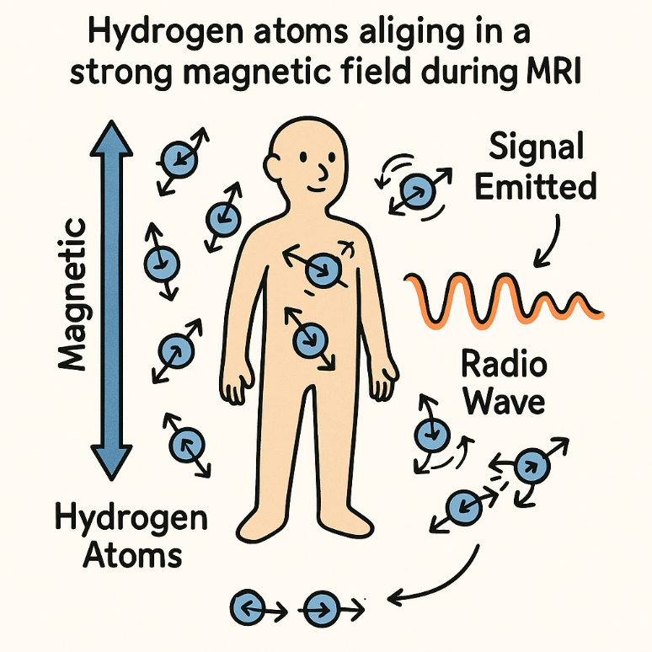
Core Physics Principles Behind MRI
MRI uses strong magnets to make hydrogen atoms in our body line up.
A special radio wave is sent in to “excite” these atoms.
When the radio wave turns off, the atoms release signals as they return to normal.
Different body parts give off different signals — that’s how we get detailed images.
Different body parts give off different signals — that’s how we get detailed images. Two types of signal timing (called T1 and T2) help tell tissues apart.

Slide 5
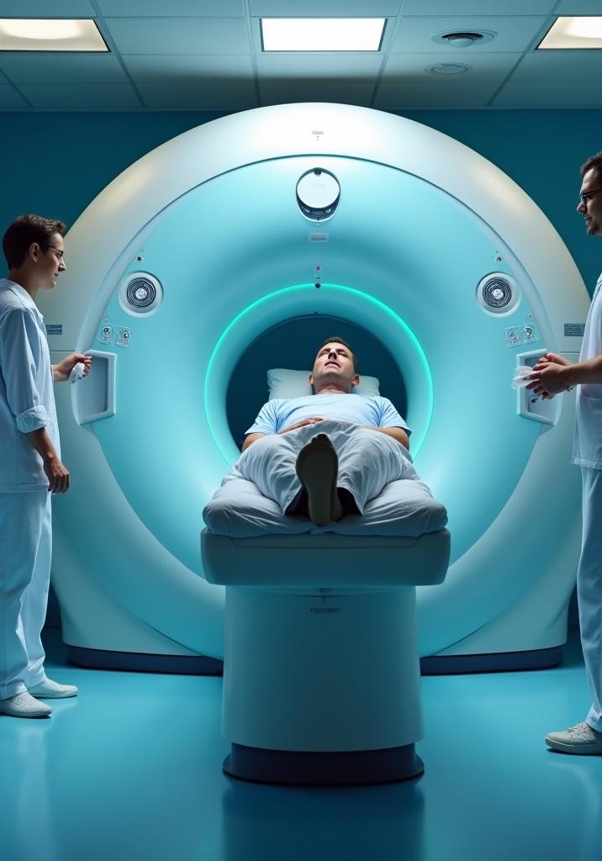
Medical Imaging Applications
MRI is widely used to assess conditions in various areas such as neurology, cardiology, and orthopedics. It's invaluable for diagnosing tumors, brain disorders, and muscle and joint issues due to its ability to provide high-resolution images without the use of ionizing radiation.

Slide 6
Physics In Real World
🔹 Magnetic Fields & Charged Particles: MRI machines use strong magnetic fields (up to 3 Tesla) to align hydrogen atoms in the body. This is based on the same concepts as uniform magnetic fields and motion of charged particles.
🔹 Electric Fields & RF Pulses: MRI sends a short radio frequency (RF) pulse, acting like a changing electric field. This excites hydrogen atoms — just like how charged particles react in electric fields.
🔹 Magnetic Flux & Faraday’s Law: When atoms relax, they release signals. This process follows Faraday’s Law of Induction: a changing magnetic field creates an electric signal, which is detected to form images.
🔹 Vector Resolution: MRI signals come from all directions. Using vector addition and resolution, software reconstructs the final image.
🔹 Gauss’s Law & Electric Fields: While not directly used by the patient, electric flux and charge distributions are key to designing uniform fields inside the machine.

Slide 7
02
CS in MRI

Slide 8
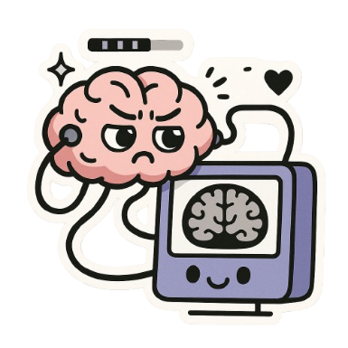
The Digital Brain
🔸 Signal Processing Raw signals from the body are just data — computer algorithms process them into images using mathematical tools like the Fourier Transform.
🔸 Image Reconstruction Special software converts wave patterns into 2D/3D images that doctors can understand.
🔸 Data Handling & Control Systems MRI machines use embedded systems and software to manage magnetic fields, timing, and image output.
🔸 User Interface & Image Storage MRI software allows technicians to select scan types and save high-resolution images to hospital systems (PACS, cloud storage).

Slide 9
Turning MRI Signals into Images
What MRI Collects: MRI doesn’t take direct pictures — it collects wave-like signals from hydrogen atoms in the body. What the Computer Does: Uses a tool called the Fourier Transform to convert wave signals into clear 2D/3D images. Easy Analogy: MRI signals are like a mix of sounds, and the computer uses math (Fourier Transform) to separate them—just like figuring out which instruments are playing in a song—to create a clear image of the body.
MRI depends on CS to convert invisible signals into visible images. No Fourier = No scan!

Slide 10
Machine Learning In MRI
Faster Scans: Machine learning helps reduce scan time by predicting missing data — making MRI quicker without losing image quality. Disease Detection: Trained models can spot signs of diseases like tumors, strokes, or Alzheimer’s by recognizing patterns in MRI images that humans might miss. Image Enhancement: ML algorithms remove noise, sharpen blurry scans, and fill in missing details — making images clearer and more useful for doctors.
What really happens behind it?
-> Thousands of labeled MRI images are used to train the system. -> The model learns to recognize patterns and make predictions on new scans. -> It’s like teaching the computer to "read" MRI images like a doctor.

Slide 11
Conclusion: MRI = Physics + Computer Science
MRI is the perfect example of how Applied Physics and Computer Science come together in the real world. Physics powers the machine: magnetic fields, radio waves, and atomic behavior. Computer Science turns signals into images and adds intelligence with machine learning. Without physics, MRI wouldn’t work. Without computer science, we couldn’t see or understand the results. Together, they make MRI one of the most powerful tools in modern medicine.

Slide 12
That’s all from us!
Do you have any questions?
youremail@email.com

